Slide 1
Making this resource work for you
Prior to teaching this lesson, please refer to the ‘Unit Overview and Planning Document’.
Further guidance on planning Science Mastery lessons can be found in the detailed planning guidance document.
Refer to the ‘notes’ section on each slide for useful information, including suggested expositions, pedagogical content knowledge, suggested questions, answers and more. Consider using presenter mode so you can see this guidance throughout the lesson.
The introduction slides can be adapted to suit your teaching style and the needs of your class.
Before the lesson, adapt the fix-it slide to address any misconceptions identified in the previous lesson’s exit ticket.
Choose from the suggested activities to suit your class. The intention is not that you complete all of these, but that you select those which ones are most appropriate for your students. It may be appropriate to further adapt activities for your students.
These lessons are designed to occupy approximately 1 hour. To adapt for a shorter or longer lesson duration we advise you to adapt the activity section accordingly.
Please consider using the final slide to send feedback about this lesson or examples of PowerPoints that you have adapted to our design team. Your feedback is used to improve Science Mastery for all of our teachers and students. We appreciate all suggestions and comments.
Thank you for reading!
The Science Mastery Team

Slide 2
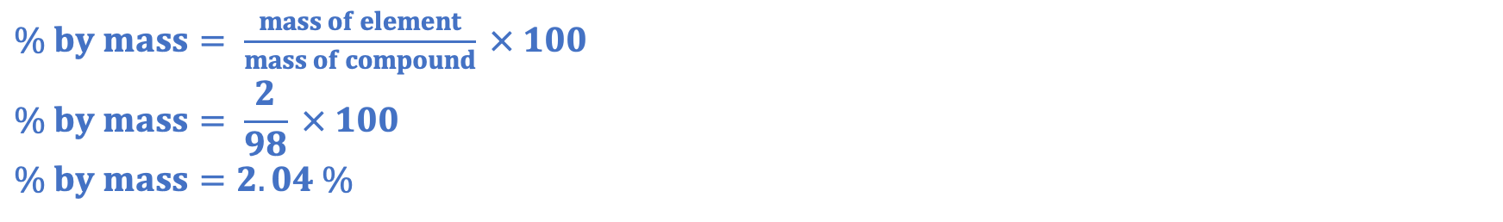
Prior Knowledge Review: Reactions of Acids
Answer the questions below.
Calculate the M_{r} of sulfuric acid (H₂SO₄). H=1, S=32, O=16
Calculate the percentage by mass of hydrogen in sulfuric acid.
Name another acid.
State the pH range of acids.
State the colour that Universal Indicator would turn in an alkaline solution.
(2x1)+32+(4x16) = 98
$\% by mass= \frac{mass of element}{mass of compound} × 100$
$$\% by mass= \frac{2}{98} × 100$$
$$\% by mass=2.04 \%$$
Hydrochloric acid, nitric acid, ethanoic acid, citric acid, carbonic acid
Less than 7, pH 1-6
Purple/blue
Notes:
Big idea: Reactions rearrange matter
Foundation: State the chemical formula for hydrochloric acid.
Stretch: Write a word equation for the reaction between calcium hydroxide and sulfuric acid.
Answers:
Foundation: HCl
Stretch: calcium hydroxide + sulfuric acid → calcium sulfate + water

Slide 3
Prior Knowledge Review: Reactions of Acids
Do Now:
Calculate the M_{r} of sulfuric acid (H₂SO₄). H=1, S=32, O=16
Calculate the percentage by mass of hydrogen in sulfuric acid.
Name another acid.
State the pH range of acids.
State the colour that Universal Indicator would turn in an alkaline solution.
Drill:
State the chemical formula for water.
State the chemical formula for carbon dioxide.
Use calculations to show whether water or carbon dioxide contains a greater percentage by mass of oxygen.
Notes:
Drill answers:
H₂O
CO₂
% by mass oxygen in water: (16/18)x100 = 88.89 %
% by mass oxygen in carbon dioxide: (32/44) = 72.73 %
Water has a higher percentage by mass of oxygen

Slide 4
Prior Knowledge Review: Reactions of Acids
Read Now:
Acids can be neutralised by alkalis (which are usually soluble metal hydroxides, like sodium hydroxide) and bases (which are insoluble metal hydroxides, like calcium hydroxide, metal oxides, like copper oxide and metal carbonates, like potassium carbonate). The reaction between an acid and a metal or a metal compound always produces a salt. If an acid reacts with a metal oxide or hydroxide, a salt and water are formed and if an acid reacts with a metal carbonate, a salt, water and carbon dioxide are formed. Sodium chloride is one example of a salt, but a salt is any compound made from a reaction between a metal and an acid.
Define a salt.
Write a general equation for a reaction between an acid and a metal oxide.
Write a general equation for a reaction between an acid and a metal hydroxide.
Write a general equation for a reaction between an acid and a metal carbonate.
Give an example of a salt.

Slide 5
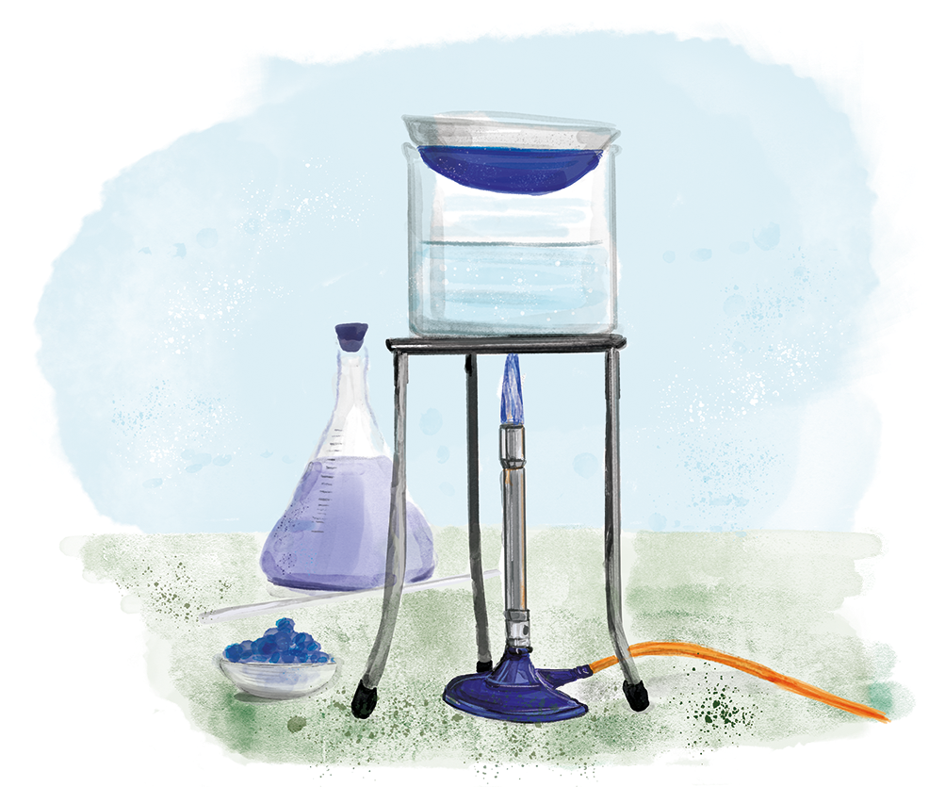
C4.3.9
03/02/2025
Prior Knowledge Review: Reactions of Acids
C4.3.1 Prior Knowledge Review
C4.3.2 (HT) Introducing the Mole
C4.3.3 (HT) Mole Calculations
C4.3.4 PKR: Concentration
C4.3.5 TIF: Calculating Concentration
C4.3.6 TIF: Calculating an Unknown Concentration
C4.3.7 (HT) Amounts of Substances in Equations
C4.3.8 (HT) Limiting Reactants
C4.3.9 PKR: Reactions of Acids
C4.3.10 Acids, Alkalis and Neutralisation
C4.3.11 TIF: Acid-Alkali Titration
C4.3.12 TIF: Acid-Alkali Titration Analysis
C4.3.13 TIF: Titration Calculations
C4.3.14 (HT) Strong and Weak Acids
C4.3.15 TIF: Volumes of Gases
Notes:
Big idea: Reactions rearrange matter
In this lesson students will review the properties of acids and their reactions, which is KS3 content. In the next lesson, they will look in more detail at acids, alkalis and neutralisation. In this lesson students will focus on writing word equations and predicting products of reactions. Determining formulae of ionic salts will be covered in the next lesson.
Suggested Hook:
What is an acid?
How could I check whether an unknown substance is an acid or not?

Slide 6

Following this lesson, students will be able to:
Write word equations for reactions with acids
Use reactants to name salts
Predict the products of chemical reactions
Key Words:
acid
base
alkali
neutralisation
chemical formula
Notes:
Guidance:
See unit overview document and planning guidance to see how these objectives are typically assessed at GCSE, including examples of what students should be able to do following this lesson.
Planning for different needs:
The learning objectives given on this slide are suggested based on the most common requirements for exams, however they can be adapted based on the needs of different classes.
For best practice, the unit preparation booklet should be used to determine the appropriate focus of lessons within the unit.
While it is not possible to explicitly split content into levelled grades, we recommend that lesson objectives can be classified as critical, core or stretch.
Critical: the content or skill is essential for all students to be able to progress.
Core: the content or skill is important for students to progress, but other opportunities may be available to revisit it.
Stretch: the content or skill may not be essential for all students but is important for students aiming for the highest grades.
Key skill: this is a crucial skill being developed in this unit as part of the skill mapping
C4.3.9 Lesson Objectives:
Critical: Write word equations for reactions with acids
Critical: Use reactants to name salts
Critical: Predict the products of chemical reactions

Slide 7
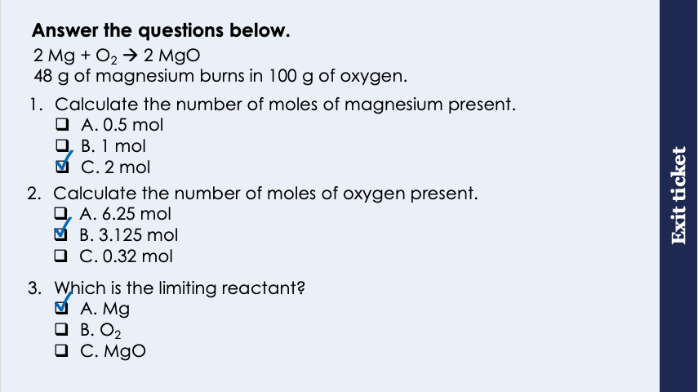
This is the fix-it portion of the lesson
The fix-it is an opportunity to respond to gaps in knowledge, especially those identified by the pre-unit quiz.
The teacher should customise this slide as needed, to facilitate
reteach, explanation, demonstration or modelling of ideas and concepts that students have not yet grasped or have misunderstood.
practise answering specific questions or of key skills.
redrafting or improving previous work.
Notes:
Purpose: to spend time on any gaps identified in previous learning from exit ticket.
Fix-it guidance from previous exit ticket:
Q1. Answer: C
If students answer A, they are have divided Mr by mass. If students answer B, they have used the coefficient to calculate the Mr. To fix it, review the equation that links number of moles, mass and Mr and give students lots of practice calculations.
Q2. Answer: B
If students answer A, it shows they have used the Ar not the Mr. If students answer C, they have divided Mr by mass. To fix it, review number of moles, mass and Mr calculations.
Q3. Answer: A
If students answer B, they have not used the mole ratio to determine the limiting reactant. If students answer C, they have not recognised that the limiting reactant needs to be a reactant. To fix it, review the meaning of a limiting reactant and model another example question for students, followed by lots of practice.

Slide 8
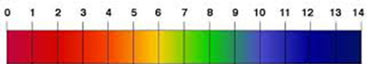
The pH Scale
The pH scale, from 0 to 14, is a measure of the acidity or alkalinity of a solution.
Aqueous solutions of alkalis have pH values greater than 7.
Substance X has a pH of 9. Is it alkaline, acidic or neutral?
A solution with pH 7 is neutral.
Alkaline
Aqueous solutions of acids have pH values of less than 7.
Notes:
Recap from C2.1 and C2.2.
Suggested exposition:
We can tell how acidic or alkaline a substance is by using the pH scale. The pH scale is measured from 0 to 14. When a solution is pH 7, it means that it is a neutral substance, so neither acidic or alkaline. When we talk about substances being acidic or alkaline, we are usually referring to aqueous solutions, which just means any solution formed when something has dissolved in water.
Are aqueous solutions compounds or mixtures?
Mixtures. The acid or alkali is not chemically bonded to the water.
Are aqueous solutions pure or impure?
Impure. They are mixtures of different compounds (acid or alkali and water).
Aqueous solutions of acids have pH values less than 7 and aqueous solution of alkalis have pH values of greater than 7.
When talking about acids, the lower the pH, the more acidic the substance - so a pH of 1 is highly acidic and a pH of 6 is less acidic.
The opposite is true when talking about alkalis: the higher the pH the more alkaline the substance - so a pH of 14 is highly alkaline and a pH of 9 is less alkaline.
Did you know?
In school science we will only talk about the pH scale going from 0 to 14 but there is a class of ‘super acids’ that have pH values lower than -12! These are extremely dangerous because they can dissolve metals on contact. Other acids also react with metals but much less vigorously, as we will see later in this unit.
Notes: Students should know that as the acid or alkali comes closer to pH 7 then its acidity or alkalinity gets weaker i.e. pH 6 is a less acidic than pH 5 and a pH 8 is a less alkaline than pH 9, pH 7 is neutral and is therefore neither acid nor alkali.
Using 0-14 and 1-14 is a contentious scientific debate. Technically neither is correct as the pH scale does not have an upper or lower limit.
Image source
https://commons.wikimedia.org/wiki/File:141128_Phil_Holliday_-_pH_scale_final.png

Slide 9
What are Acids and Alkalis? The tables below shows common acids and alkali that can be found in the laboratory.
Common Acids | Chemical Formula
Hydrochloric Acid | HCl
Nitric Acid | HNO₃
Sulfuric Acid | H₂SO₄
Common Alkalis | Chemical Formula
Sodium Hydroxide | NaOH
Potassium Hydroxide | KOH
Calcium Hydroxide | Ca(OH)₂
What similarities and differences can you see in the chemical formulae?
Notes:
Recap from C2.1 and C2.2.
Suggested script:
The words ‘alkali’ and ‘base’ are sometimes used to mean the same thing, however there is a difference. A base is a substance that can react with acids and neutralise them. Bases are usually: metal oxides, such as copper oxide, metal hydroxides, such as sodium hydroxide, or metal carbonates, such as calcium carbonate.
Many bases are insoluble - they do not dissolve in water. However, if a base does dissolve in water, we can call it an alkali.
Note: Students will need to know the formulae of these common laboratory acids and alkalis.
What do each of the three acids and alkalis have in common?
The acids all contain Hydrogen (H) and the alkalis all contain an OH (hydroxide).
These ions will be revisited in the next lesson.

Slide 10
What happens in a neutralisation reaction?
A salt is formed when the hydrogen in an acid is replaced by a metal.
salt
Potassium hydroxide + hydrochloric acid → Potassium chloride + water
O
H
Cl
H
H
K
→
K
+
+
H
Cl
O
KOH + HCl → KCl + H₂O
KOH + HCl → KCl + H₂O
The ‘H’ in ‘HCl’ is replaced with the ‘K’ from ‘KOH’.
The OH from the alkali and H from the acid form H₂O (water).
Notes:
Recap from C2.1 and C2.2.
Suggested exposition:
A salt is formed when the hydrogen in an acid is replaced by a metal. Looking at this example where potassium hydroxide (this is our alkali, which we know this due to the presence of hydroxide) reacts with hydrochloric acid (this is an acid due to the presence of hydrogen ion). The atoms in these compounds are rearranged to form salt and water.

Slide 11

How many ways can neutralisation happen?
Did you know?
Calcium carbonate can be found in rocks as a mineral.
Alkalis/Bases
They react with acids to produce salt and water.
These can be metal oxides or metal hydroxides.
Metal Carbonates
A metal carbonate is a compound containing a metal, carbon and oxygen. They react with acids to produce a salt, water and carbon dioxide.
Acid + Alkali → Salt + Water
Acid + Base → Salt + Water
Acid + Metal Carbonate → Salt + Water + Carbon Dioxide
Notes:
Recap from C2.1 and C2.2.
Suggested exposition:
Neutralisation can happen in a few ways. Firstly, acids can react with alkalis to make salt and water. Notice that there is the word base next to alkali, an alkali is a type of base that are soluble while most bases are solid.
The general equations for the reactions of alkalis and bases with water are similar:
Acid + alkali → salt + water
Acid + base → salt + water
The other way neutralisation can happen is by reacting acids with metal carbonates. Metal carbonates are compounds that contain metal, carbon and oxygen (remember the meaning of the suffix -ate). Metal carbonates react with acids to produce salt and water, plus another product, carbon dioxide. Because of this, if we do this reaction in the lab, we will notice that there are bubbles forming or fizzing (can use example of opening a can of coke where CO₂ fizzes out. When we made a salt using an acid and a base, no bubbles were formed because there was not a gas produced as a product.
The general equation for the reaction between metal carbonates is: Acid + metal carbonate → salt + water + carbon dioxide

Slide 12
How many ways can neutralisation happen?
A base is a substance that can react with acids and neutralise them. Most are insoluble.
Examples of bases: copper oxide (CuO), zinc oxide (ZnO)
Examples of alkalis: sodium hydroxide (NaOH), potassium hydroxide (KOH)
Examples of carbonates: copper carbonate (CuCO₃), calcium carbonate (CaCO₃)
Alkalis are soluble bases.
Carbonates are bases, they are insoluble and neutralise acids to make salt, water and carbon dioxide.
Notes:
Recap from C2.1 and C2.2.
Suggested exposition:
We will now review each of these substances and look at examples for each.
Bases:
A base is a substance that can react with acids and neutralise them and most bases are insoluble.
What does insoluble mean?
Cannot dissolve in water.
Examples of bases are many metal oxides, such as copper oxide and zinc oxide.
Alkalis:
Alkalis are soluble bases. This means they can also react with acids and neutralise them but the difference is that alkalis are soluble.
What does soluble mean?
Can dissolve in water. This means that most alkalis are aqueous solutions.
Examples of alkalis are many hydroxides, including sodium hydroxide and potassium hydroxide.
Was the magnesium oxide we used to make a salt a base or an alkali?
It is a base since it is insoluble.
How do we know that it is insoluble?
Because it can be filtered out from the solution.
Carbonates:
Carbonates are also bases and are also insoluble. They can neutralise acids to form a salt, water and carbon dioxide.
Carbonates are also bases, the difference is that when carbonates reacts with acid, carbon dioxides are also produces along with salts and water.
Examples of carbonates are copper carbonate and calcium carbonate.

Slide 13
Neutralisation reactions
Acid + alkali → salt + water
Acid + base → salt + water
Acid + metal carbonate → salt + water + carbon dioxide
These are neutralisation reactions because:
Acid
Alkali/Base or metal carbonate
→
water
+
+ salt (and carbon dioxide)
Acid + metal reactions are not neutralisation reactions.
Notes:
Purpose: to introduce new learning.
Suggested guidance: Get pupils to think of sentences to remember these acronyms - you may want to include this as part of the talk task.
Acid and metal reactions are not neutralisation reactions but displacement reactions. They do not produce water.
These are suggestions:
MASH
Metal + acid → salt + hydrogen
BASW (not as catchy but BASH means that water and hydrogen can get confused)
Base + acid → salt + water
CASWCO
(metal) carbonate → salt + water + CO2

Slide 14
Naming salts
Hydrochloric acid produces chloride salts
e.g. hydrochloric acid + sodium hydroxide → sodium chloride + water
e.g. nitric acid + sodium hydroxide → sodium nitrate + water
e.g. sulfuric acid + sodium hydroxide → sodium sulfate + water
Nitric acid produces nitrate salts e.g. sodium nitrate
Sulfuric acid produces sulfate salts e.g. sodium sulfate
Notes:
Recap from C2.1 and C2.2.
Suggested exposition:
There are many different types of salts that exist. Salts are named in the same way that we name other compounds: the first word or part of the name is from the metal and the second part is from the non-metal. We know that there is a compound because the suffix is ’-ide’, ’-ate’, or ‘-ite’.
What is the difference between -ide and -ate?
-Ate means that oxygen is also present in the compound.
Different acids produces different types of salts. For example, hydrochloric acid produces chloride salts, nitric acids produces nitrate salts and sulfuric acid produces sulfate salts. The first part of the name of the salt comes from the metal but the second part comes from the acid - we call these the types of salt, e.g. chlorides, nitrates and sulfates.
Note:
Would be a good idea here to stress that the metal atom of the salt comes from the alkali.
Video link (optional) :
https://www.youtube.com/watch?v=JLDzv18noKA&list=PLW0g+avSzhMlReKGMVfUt6YuNQsO0bqSMV&index=137&t=0s

Slide 15
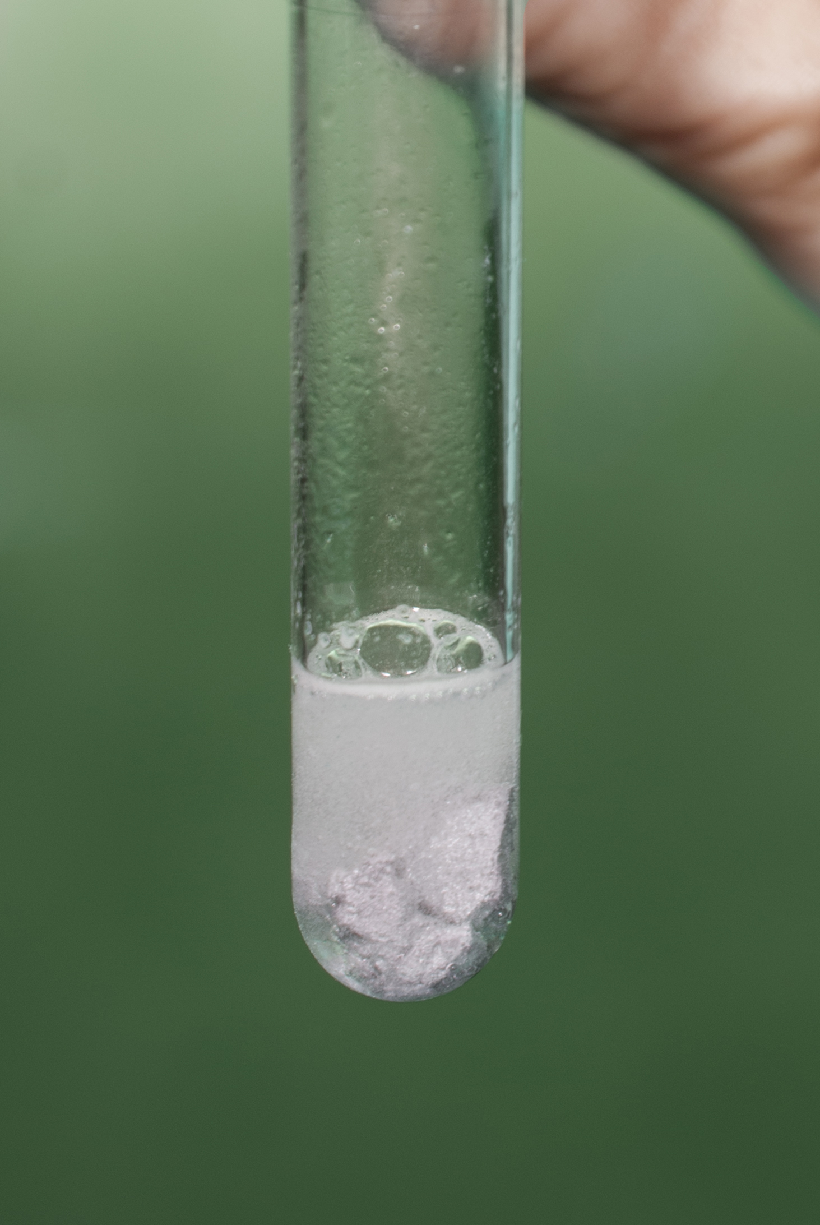
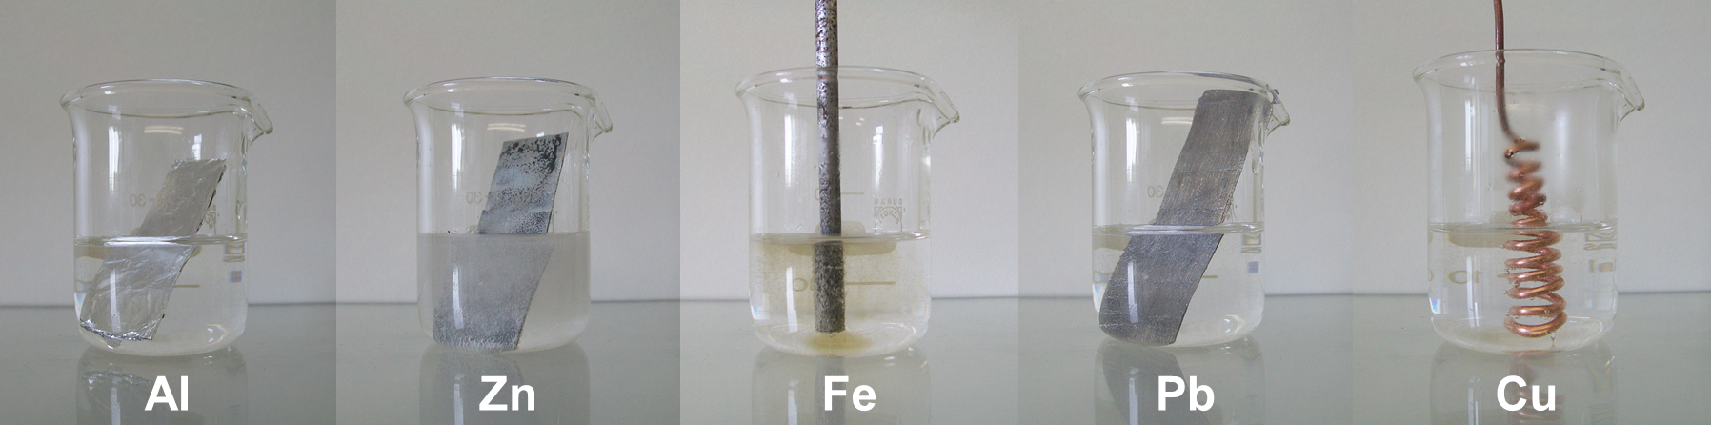
Acids and Metals
Acids react with metals to product salt and hydrogen.
Metal + Acid → Salt + Hydrogen
Magnesium + hydrochloric acid → magnesium chloride + hydrogen
Mg + 2 HCl→ MgCl₂ + H₂
Notes:
Recap from C2.1 and C2.2.
We also know from C2.1 and C2.2 that acids can also react with metals. When an acid reacts with a metal, a salt and hydrogen gas is produced.
These are not neutralisation reactions. They are displacement reactions, so are redox reactions.
What are redox reactions?
Reactions in which one species is oxidized while another is reduced.
What is reduction?
When a substance gains electrons.
What is oxidation?
When a substance loses electrons.
Right Image:© Adam Rędzikowski / Wikimedia Commons / CC BY-SA 4.0: link: https://creativecommons.org/licenses/by-sa/4.0/deed.en
Left image: © Capaccio / Wikimedia Commons / CC link: https://creativecommons.org/licenses/by-sa/3.0/

Slide 16
(HT) Writing ionic equations
Use your list of ions handout to help!
Look at this chemical equation:
Mg_{(s)} + H₂SO_{4(aq)} → MgSO_{4(aq)} + H_{2(g)}
We can use 2 steps to write this as an ionic equation:
Step 1: Split up the aqueous (aq) substances into their ions
Mg_{(s)} + 2H⁺_{(aq)} + SO₄²⁻_{(aq)} → Mg²⁺_{(aq)} + SO₄²⁻_{(aq)} + H_{2(g)}
Step 2: Delete the spectator ions (the ones that appear on both sides)
Mg_{(s)} + 2H⁺_{(aq)} → Mg²⁺_{(aq)} + H_{2(g)}
Notes:
Exposition type: Explanation
Model teacher exposition:
We are going to look at how to write ionic equations. These equations will become increasingly important as we work through this unit, so we want to ensure you are secure in writing these.
We can start with a regular chemical equation.
Just like we did earlier in the lesson, let’s first break up any of the aqueous substances into their ions – that’s step 1.
Use the list of ions that you have been provided to check the charges on each ion carefully, and make sure the state symbols are written.
When we break up an aqueous substance into its ions, each of those will also be aqueous, so just keep the same state symbol.
Now, look on each side of the equation (each side of the arrow).
Are there any species that are exactly the same on each side? Yes
These are called the spectator ions, and we don’t want these in our final equation. So I’m going to rewrite the equation without these.
Our final result is an ionic equation.

Slide 17
(HT) Writing ionic equations
The equation for the reaction between zinc and hydrochloric acid is as follows:
Zn_{(s)} + 2HCl _{(aq)} → ZnCl_{2 (aq)} + H_{2(g)}
Metal + Acid → Salt + Hydrogen
1. Write an ionic equation for this reaction
Zn_{(s)} + 2H⁺_{(aq)} → Zn²⁺_{(aq)} + H_{2(g)}
2. Explain which species is reduced in this reaction.
Hydrogen is reduced in this reaction because it gains electrons

Slide 18


Testing for Gases
POP
Metal + Acid → Salt + Hydrogen
The test for hydrogen uses a burning splint held at the open end of a test tube of the gas.
Hydrogen burns rapidly with a pop sound.
This is called the squeaky pop test.
Test tube of hydrogen gas
Notes:
Recap from C2.1 and C2.2.
Suggested script:
We have already looked at some different types of chemical reactions, usually where we know the reactants because we have chosen them ourselves. If we have unknown substances we can work backwards from the products using our general equations to work out what the reactants were. For us to be able to do this, we can test the gases that are produced in the reaction.
What is the general equation for a reaction between an acid and a metal?
Acid + metal → salt + hydrogen
In these reactions, hydrogen gas is produced. We can test for hydrogen gas using the squeaky pop test. This test involves using a burning splint held over the open end of a test tube of the gas. If hydrogen gas is present it burns rapidly with a ‘pop’ sound, which is a positive test result. If hydrogen is not present, there will be no squeaky pop, which is a negative result.
If we have a positive test result we know that hydrogen has been produced so this tells us that one of the reactants may have been a metal, rather than an alkali/base or metal carbonate.
Images: pixabay

Slide 19

Testing for Gases
Metal Carbonate + Acid → Salt + Water + Carbon dioxide
The test for carbon dioxide gas uses a solution of calcium hydroxide (also called limewater).
When carbon dioxide is shaken with or bubbled through limewater, the limewater turns milky (cloudy).
Turns milky
Notes:
Recap from C2.1 and C2.2.
Suggested script:
We have already looked at some different types of chemical reactions, usually where we know the reactants because we have chosen them ourselves. If we have unknown substances we can work backwards from the products using our general equations to work out what the reactants were. For us to be able to do this, we can test the gases that are produced in the reaction.
What is the general equation for a reaction between an acid and a metal?
Acid + metal → salt + hydrogen
In these reactions, hydrogen gas is produced. We can test for hydrogen gas using the squeaky pop test. This test involves using a burning splint held over the open end of a test tube of the gas. If hydrogen gas is present it burns rapidly with a ‘pop’ sound, which is a positive test result. If hydrogen is not present, there will be no squeaky pop, which is a negative result.
If we have a positive test result we know that hydrogen has been produced so this tells us that one of the reactants may have been a metal, rather than an alkali/base or metal carbonate.
Hydrogen gas picture: https://www.flickr.com/photos/121935927@N06/13580153074
Carbon dioxide apparatus picture: https://www.flickr.com/photos/internetarchivebookimages/20555984059/

Slide 20




Which statements do you agree with?
Houria: Carbonate salts are formed when acid reacts with metal carbonates
Jo: Alkalis are bases
Sam: Reaction between acid and metal carbonates forms bubbles due to oxygen being released
Maysa: Acids reacting with metals are an example of neutralisation
Notes:
Expected Answers:
Jo (correct): Alkalis and metal carbonates are bases. This is because bases are substances that can react with acid to neutralise them. Both alkali and metal carbonates have that ability.
Sam (wrong): The reaction between acid and metal carbonates forms salt, water and carbon dioxide. The bubbles formed are due to carbon dioxide being produced not oxygen.
Houria (Wrong): Carbonates salts are used in a neutralisation reaction with acid but the salts of the acid is formed. For example, the salt formed by the reaction of Calcium Carbonate and hydrochloric acid is Calcium Chloride. Therefore, rathe than carbonate salts being formed, chloride salts were formed.
Maysa (wrong): This is a common misconception. Acid+ metal is a displacement reaction, not a neutralisation reaction.
Suggested guidance:
Talk tasks can be used in a variety of ways to suit the particular needs of the students you are teaching. Through exchanging views with others, students develop their understanding of the science beyond what could be achieved individually.
Science classrooms that successfully integrate talk have the following features:
Science talk is a regular feature of lessons and is woven into classroom activities.
Students are paired or grouped strategically by the teacher to ensure productive interaction. This might take into consideration the students’ proficiency of the English language, how encouraging they might be to peers and their attainment in the topic. It’s a good idea to consider these pairings in the class seating plan.
Students are encouraged and supported to talk, but are not forced to talk.
The teacher should take on the role of a facilitator, engaging with conversations where necessary and encouraging or steering the conversation where needed.
Students are encouraged to use the language they have to express their ideas (e.g., everyday language, imperfect English, native language), but also to incorporate science specific terminology where this is more accurate or has been taught.
6. Scientifically inaccurate ideas are not dismissed by the partner or teacher; open discussion and further investigation are relied on to help students construct ideas that support them to progress in their scientific understanding.
7. Guidelines for behaviour during talk tasks are explicit and frequently reviewed. Rules for students might be:
Listen carefully to your partner
Take turns talking.
Speak one at a time, without interrupting.
Politely agree or disagree and explain why.
Politely point out if your partner has used a scientific word incorrectly, if they have explained the science incorrectly, or if there is a more accurate way to describe something.
If confused, ask questions.
Stay focused on the discussion topic.
Respond to one another.

Slide 21
A student has samples copper carbonate, copper oxide and copper. How could they use chemical tests to prove which is which?
POP
What would they expect if they reacted a sample of each with an acid?
What chemicals could be used to test for the products of these reactions?
What would a positive test result be?
Notes:
Suggested points:
Each sample should be reacted with an acid (hydrochloric, nitric or sulfuric)
The metal would react with the acid to produce a salt and hydrogen gas
If a lit splint was held over the top of this reaction it would burn with a squeaky pop
The metal carbonate would react with the acid to produce a salt, water and carbon dioxide
If limewater was bubbled through this solution, it would turn milky/cloudy
This means they could identify the metal and the metal carbonate. The metal oxide would be the one left over.
Suggested guidance:
Talk tasks can be used in a variety of ways to suit the particular needs of the students you are teaching. Through exchanging views with others, students develop their understanding of the science beyond what could be achieved individually.
Science classrooms that successfully integrate talk have the following features:
Science talk is a regular feature of lessons and is woven into classroom activities.
Students are paired or grouped strategically by the teacher to ensure productive interaction. This might take into consideration the students’ proficiency of the English language, how encouraging they might be to peers and their attainment in the topic. It’s a good idea to consider these pairings in the class seating plan.
Students are encouraged and supported to talk, but are not forced to talk.
The teacher should take on the role of a facilitator, engaging with conversations where necessary and encouraging or steering the conversation where needed.
Students are encouraged to use the language they have to express their ideas (e.g., everyday language, imperfect English, native language), but also to incorporate science specific terminology where this is more accurate or has been taught.
6. Scientifically inaccurate ideas are not dismissed by the partner or teacher; open discussion and further investigation are relied on to help students construct ideas that support them to progress in their scientific understanding.
7. Guidelines for behaviour during talk tasks are explicit and frequently reviewed. Rules for students might be:
Listen carefully to your partner
Take turns talking.
Speak one at a time, without interrupting.
Politely agree or disagree and explain why.
Politely point out if your partner has used a scientific word incorrectly, if they have explained the science incorrectly, or if there is a more accurate way to describe something.
If confused, ask questions.
Stay focused on the discussion topic.
Respond to one another.

Slide 22
Complete the equations below:
Salt + water
Acids + alkali/base →
Acids + metal carbonate →
Hydrochloric acid + lithium oxide →
Nitric acid + magnesium hydroxide →
Sulfuric acid + copper carbonate →
Hydrochloric acid + calcium carbonate →
Salt + water + carbon dioxide
Lithium chloride + water
Magnesium nitrate + water
Copper sulfate + water + carbon dioxide
Calcium chloride + water
+ carbon dioxide

Slide 23
Drill
State the general equation for the reaction between an acid and an alkali.
State the general equation for the reaction between an acid and an metal carbonate.
State the general equation for the reaction between an acid and a metal.
Describe a positive test for hydrogen.
Describe a positive test for carbon dioxide.
True or false: the reaction between an acid and a metal is an example of neutralisation.
Notes:
Purpose: This is a knowledge drill. The purpose of this is to check that the critical knowledge is secure before pupils move onto independent practice.
Suggested guidance: There are a range of ways this could be done depending on time and ability range of the class:
Mini whiteboards
As full sentences in exercise books
As short answers in exercise books
In the pupil workbook
As pair talk
As cold call

Slide 24
Drill answers
Acid + alkali → salt + water
Acid + metal carbonate → salt + water + carbon dioxide
Acid + metal → salt + hydrogen
A lit splint burns with a squeaky pop
Limewater turns milky/cloudy
False
Notes:
Purpose: This is a knowledge drill. The purpose of this is to check that the critical knowledge is secure before pupils move onto independent practice.
Suggested guidance: There are a range of ways this could be done depending on time and ability range of the class:
Mini whiteboards
As full sentences in exercise books
As short answers in exercise books
In the pupil workbook
As pair talk
As cold call

Slide 25
I: predicting the products of a reaction
A student reacts hydrochloric acid with magnesium carbonate.
What salt would be produced in this reaction?
Magnesium chloride
What would the other product(s) of this reaction be?
Water and carbon dioxide
Write this as a word equation.
Hydrochloric acid + magnesium carbonate → magnesium chloride + water + carbon dioxide
How could you test for the presence of carbon dioxide?
Bubbling through limewater. If limewater turns milky/cloudy carbon dioxide is present.
What type of reaction is this?
Neutralisation
Notes:
Purpose: The I-We-You section aims to support pupils to build skills that they most commonly need when answering questions associated with this knowledge in the assessment. This section is also used to interleave other content we expect pupils to know at this stage of their education in order that they build a big picture of the science they are learning.
For the ‘I’ activity, the teacher should model how to answer the question. They can do this by narrating their thinking process aloud, and making links to learning earlier in the lesson explicit.
For the ‘we’ activity, the teacher and students work though a similar example together, in order to prepare students to be able to answer a similar question independently.
Opportunities for the ‘you’ activity – independent practise – occur in the activity portion of the lesson once the student is secure enough to process independently.

Slide 26
We: predicting the products of a reaction
A student reacts copper oxide with sulfuric acid.
What salt would be produced in this reaction?
copper sulfate
What would the other product(s) of this reaction be?
Water
Write this as a word equation.
Copper oxide + sulfuric acid → copper sulfate + water
What would the products of these show for the squeaky pop test?
A negative result. Hydrogen gas is not produced.
What type of reaction is this?
Neutralisation
Notes:
Purpose: The I-We-You section aims to support pupils to build skills that they most commonly need when answering questions associated with this knowledge in the assessment. This section is also used to interleave other content we expect pupils to know at this stage of their education in order that they build a big picture of the science they are learning.
For the ‘I’ activity, the teacher should model how to answer the question. They can do this by narrating their thinking process aloud, and making links to learning earlier in the lesson explicit.
For the ‘we’ activity, the teacher and students work though a similar example together, in order to prepare students to be able to answer a similar question independently.
Opportunities for the ‘you’ activity – independent practise – occur in the activity portion of the lesson once the student is secure enough to process independently.

Slide 27
You: predicting the products of a reaction
A student reacts nitric acid with zinc.
What salt would be produced in this reaction?
Zinc nitrate
What would the other product(s) of this reaction be?
Hydrogen
Write this as a word equation.
Nitric acid + zinc→ zinc nitrate + hydrogen
How could you test for the presence of hydrogen?
A lit splint burns with a squeaky pop
What type of reaction is this?
Displacement/redox
Notes:
Purpose: The I-We-You section aims to support pupils to build skills that they most commonly need when answering questions associated with this knowledge in the assessment. This section is also used to interleave other content we expect pupils to know at this stage of their education in order that they build a big picture of the science they are learning.
For the ‘I’ activity, the teacher should model how to answer the question. They can do this by narrating their thinking process aloud, and making links to learning earlier in the lesson explicit.
For the ‘we’ activity, the teacher and students work though a similar example together, in order to prepare students to be able to answer a similar question independently.
Opportunities for the ‘you’ activity – independent practise – occur in the activity portion of the lesson once the student is secure enough to process independently.

Slide 28

Compare: to outline the similarities and/or differences between things
Example question:
Compare the products of a reaction between an acid and an alkali and an acid and a metal carbonate.
To ‘compare’, your answer should:
Give similarities.
Write paired statements that show differences relating to the same feature.
Use the term ‘whereas’ to link your statements.
Model answer:
Both are examples of neutralisation reactions
Both reactions produce a salt
Both reactions produce water
The reaction between an acid and a metal carbonate also produces carbon dioxide, whereas the reaction between an acid and an alkali does not

Slide 29
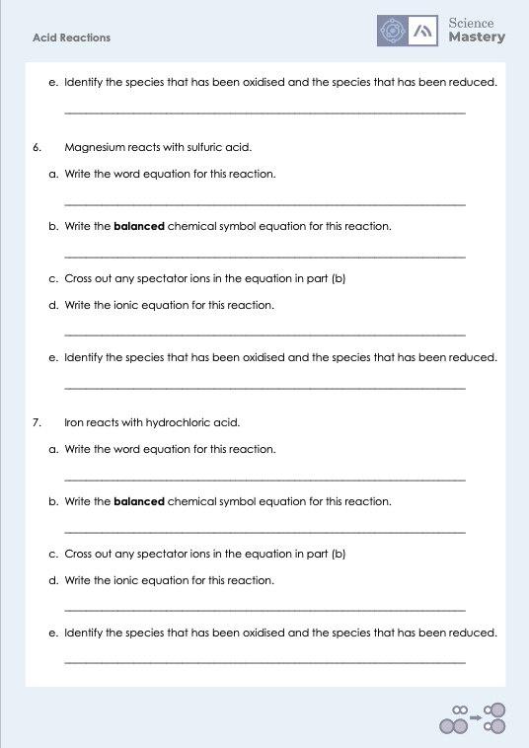
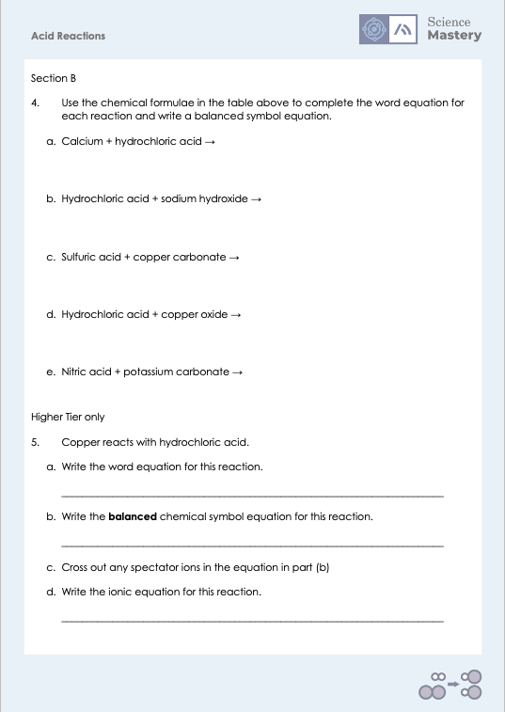
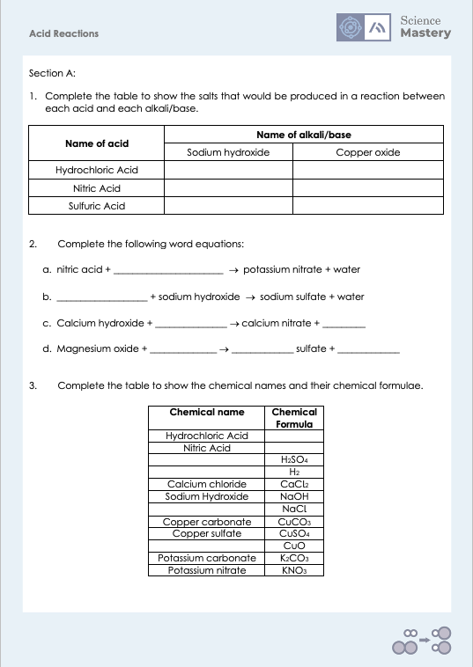
Acid Reactions

Slide 30
Answers
1.
Name of acid | Name of alkali/base
 | Sodium hydroxide | Copper oxide
Hydrochloric Acid
Nitric Acid
Sulfuric Acid
sodium chloride
copper chloride
sodium nitrate
copper nitrate
sodium sulfate
copper sulfate
2a.
Nitric acid + potassium oxide/potassium hydroxide → potassium nitrate + water
2b.
Sulfuric acid + sodium hydroxide → sodium sulfate + water
2c.
Calcium hydroxide + nitric acid → calcium nitrate + water
2d.
Magnesium oxide + sulfuric acid → magnesium nitrate + water

Slide 31
Answers
3.
Chemical name | Chemical Formula
Hydrochloric Acid
Nitric Acid
 | H₂SO₄
 | H₂
Calcium chloride | CaCl₂
Sodium Hydroxide | NaOH
 | NaCl
Copper carbonate | CuCO₃
Copper sulfate | CuSO₄
 | CuO
Potassium carbonate | K₂CO₃
Potassium nitrate | KNO₃
HCl
HNO₃
Sulfuric acid
Hydrogen gas
Sodium chloride
Copper oxide

Slide 32
Answers
4a.
Calcium + hydrochloric acid → calcium chloride + hydrogen
Ca + 2 HCl → CaCl₂ + H₂
4b.
Hydrochloric acid + sodium hydroxide → sodium chloride + water
HCl + NaOH → NaCl + H₂O
4c.
Sulfuric acid + copper carbonate → copper sulfate + water + carbon dioxide
H₂SO₄ + CuCO₃ → CuSO₄ + H₂O + CO₂
4d.
Hydrochloric acid + copper oxide → copper chloride + water
2 HCl + CuO → CuCl₂ + H₂O
4e.
Nitric acid + potassium carbonate → potassium nitrate + water + carbon dioxide
2 HNO₃ + K₂CO₃ → 2 KNO₃ + H₂O + CO₂
Notes:
Purpose: students practise using and applying their new knowledge
This slide accompanies a worksheet for students. Ask students to complete the table section of the worksheet first and then correct this before moving on to ensure incorrect answers at this stage don’t affect answers for the equation writing portion of the sheet.

Slide 33
Answers
5a.
Copper + hydrochloric acid → copper chloride + hydrogen
5b.
Cu + 2 HCl→ CuCl₂+ H₂
5d.
Cu + 2 H⁺→ Cu²⁺ + H₂
5e.
H⁺ has been reduced, Cu has been oxidised
6a.
Magnesium + sulfuric acid → magnesium sulfate + hydrogen
5b.
Mg + H₂SO₄→ MgSO₄+ H₂
5d.
Mg + 2 H⁺→ Mg²⁺ + H₂
5e.
H⁺ has been reduced, Mg has been oxidised

Slide 34
Answers
5a.
Iron + hydrochloric acid → iron chloride + hydrogen
5b.
Fe + 2 HCl→ FeCl₂+ H₂
5d.
Fe + 2 H⁺→ Fe²⁺ + H₂
5e.
H⁺ has been reduced, Fe has been oxidised

Slide 35
Answer the questions below.
Name the salt that would be produced when hydrochloric acid reacted with potassium hydroxide.
A. Potassium hydride
B. Potassium chloride
C. Potassium chlorine
✓
2. The products of which reaction would give a positive squeaky pop test?
A. Nitric acid + calcium oxide
B. Nitric acid + calcium carbonate
C. Nitric acid + calcium
✓
Which of these is not a neutralisation reaction?
A. Acid + metal
B. Acid + metal hydroxide
C. Acid + metal carbonate
✓
Notes:
Q1. Answer: B
If students answer A, they know that a compound ends ‘ide’ but have not recalled that hydrochloric acid makes chloride salts. If students answer C, they recognise that chlorine is involved but not the key part that it is the chloride ion in the compound. To fix-it, review the rules for naming salts and give students lots of practice.
Q2. Answer: C
If students answer A, it shows they are not clear on the reaction between an acid and a base. If students answer B, they have confused the squeaky pop test and the limewater test. To fix-it, review what the squeaky pop test and the limewater test detect the presence of and give students practice of identifying from reactants which pairs will produce positive results.
Q3. Answer: A
If students answer B or C, it shows that students are not clear on the meaning of a neutralisation reaction. This will be addressed in the next lesson. To fix-it, review the definition of a neutralisation reaction and show students the ions involved.

Slide 36
Lesson C4.3.9
What was good about this lesson? | What can we do to improve this lesson?
Send us your feedback by clicking this link
or by emailing sciencemastery@arkonline.org
Thank you!

